Slide 1
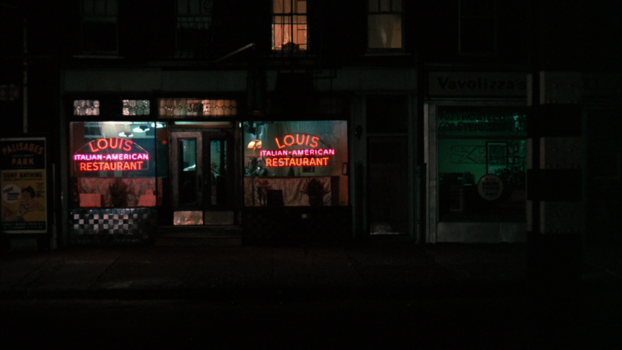
Where in Raleigh, NC Should I Open an Italian Restaurant?
Scott Josephson | Applied Data Science Capstone | 1/7/19

Slide 2
Introduction
A friend is looking to open an Italian Restaurant in Raleigh, NC.
Research performed on relevant venues which fall under specific categories:
Italian Restaurants
Cafes
Shopping
Nightlife
It is believed that his restaurant will do well in area which has many other venues.

Slide 3
Data
Four categories of venue data:
Italian Restaurants
Cafes
Shopping
Nightlife
Get geospatial data from Google using its geocode API
Get data from Foursquare using its API

Slide 4
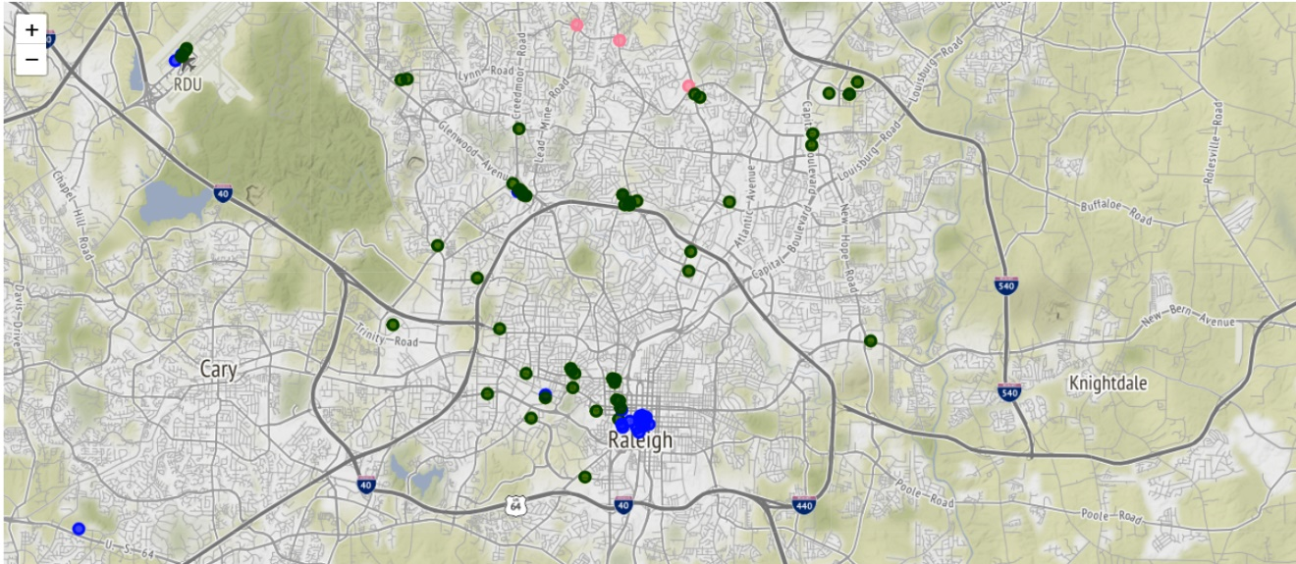
Methodology
Gather the 15 zip codes from Raleigh
Obtain latitude and longitude coordinates using Google Geocode
Create Folium Geopsatial maps and display venues by their geocodes

Slide 5
Results
Used K-Means clusters to group venues into their zip codes.
Determined 4 clusters was the best amount to run k-means with.
A listing of zip codes and their count of four category venues listed in them.

Slide 6
Discussion
Recommendation will be made to open restaurant in the zip code 27601 which showed to have the largest count of category venues in them.

Slide 7
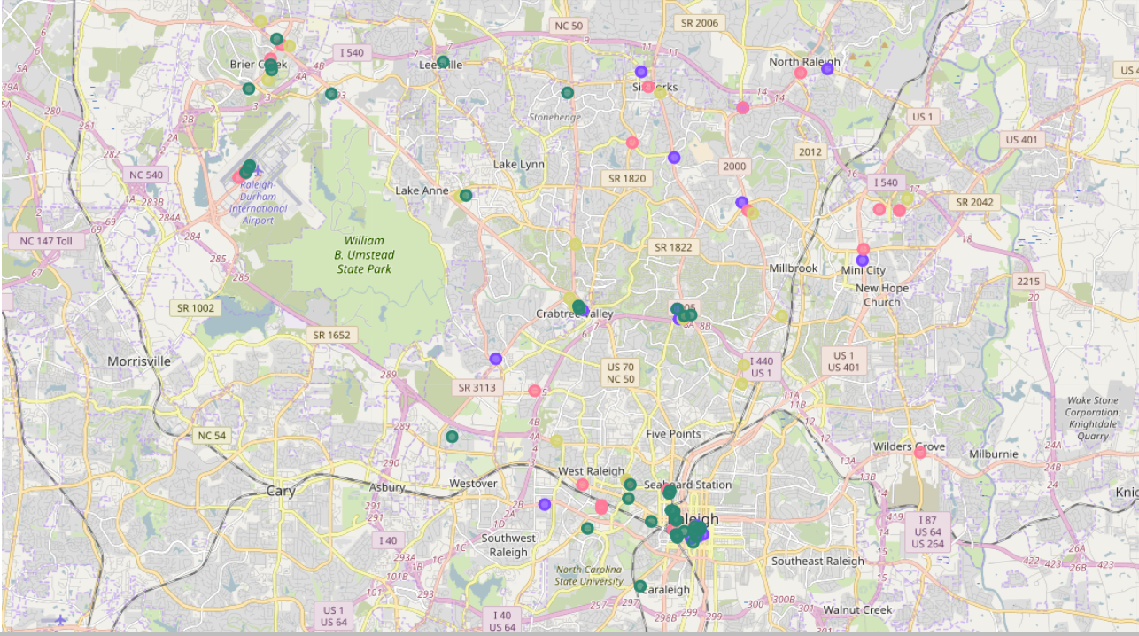
Conclusion
The final map of the Raleigh areas with its color coded categories placed in the specific zip code areas.

